Slide 1
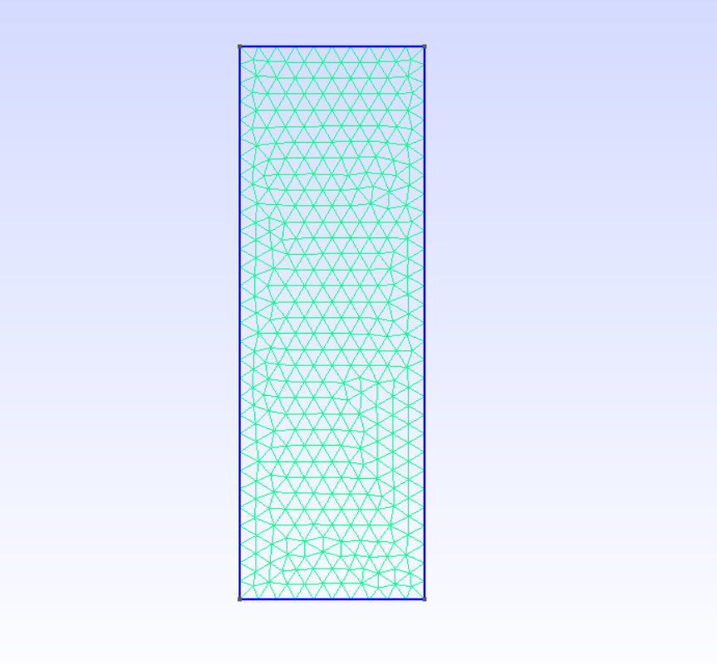
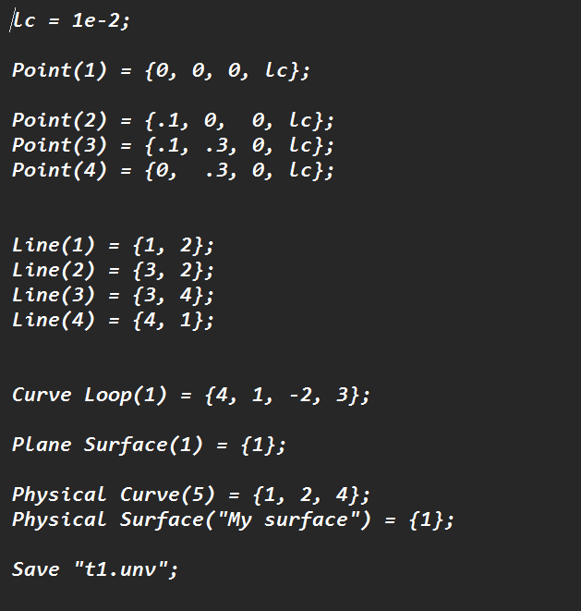
Geometry In Gmsh
Handles CAD-style geometry with points, curves, surfaces, and volumes.
Maintains exact topological connections (no accidental gaps or overlaps).
Supports both simple shapes and fully parametric CAD-like models.

Slide 2
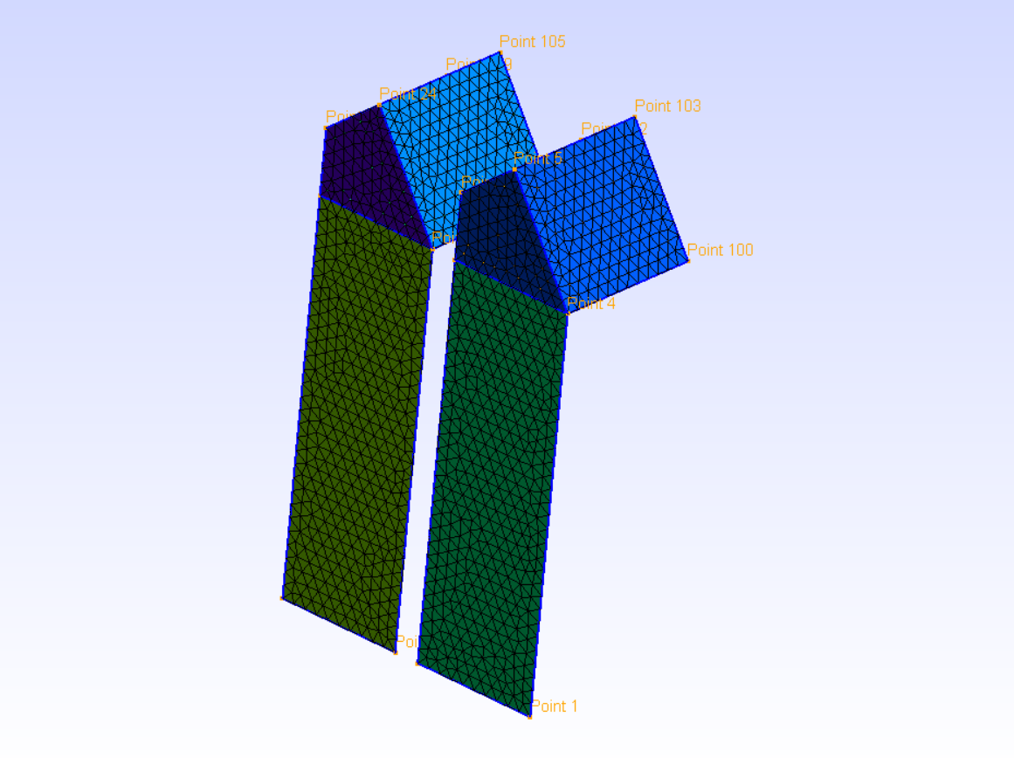
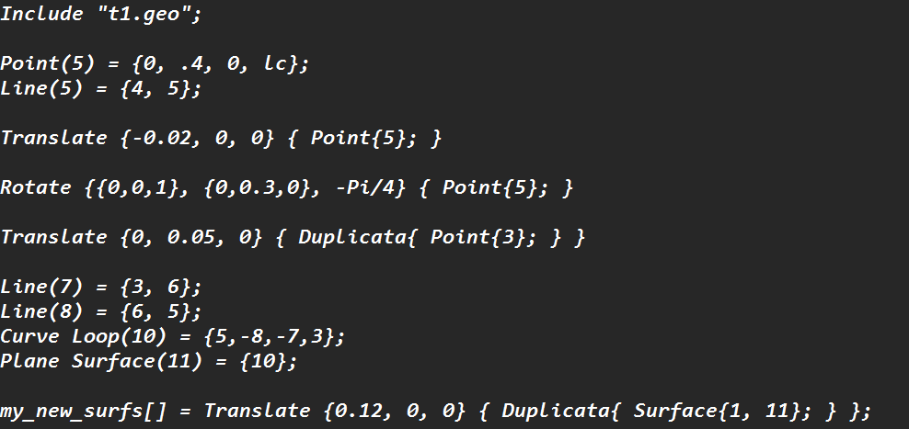
We can move, rotate & duplicate geometry & mesh in gmsh scripting

Slide 3
MeshSize
Provides precise control of local and global mesh refinement.
Handles user-defined and auto-generated points consistently.
Lets you enforce final mesh resolution using overriding conditions.
What is Lc?
The definition of lc in Gmsh is the characteristic length. It serves as the primary parameter to control the target size or resolution of the mesh elements.
If you have a line that is 10 units long :
If you set lc = 1 Gmsh will try to place nodes every 1 unit, resulting in roughly 10 segments (11 nodes).
If you set lc = 5 it will try to place nodes every 5 units, resulting in roughly 2 segments (3 nodes).

Slide 4
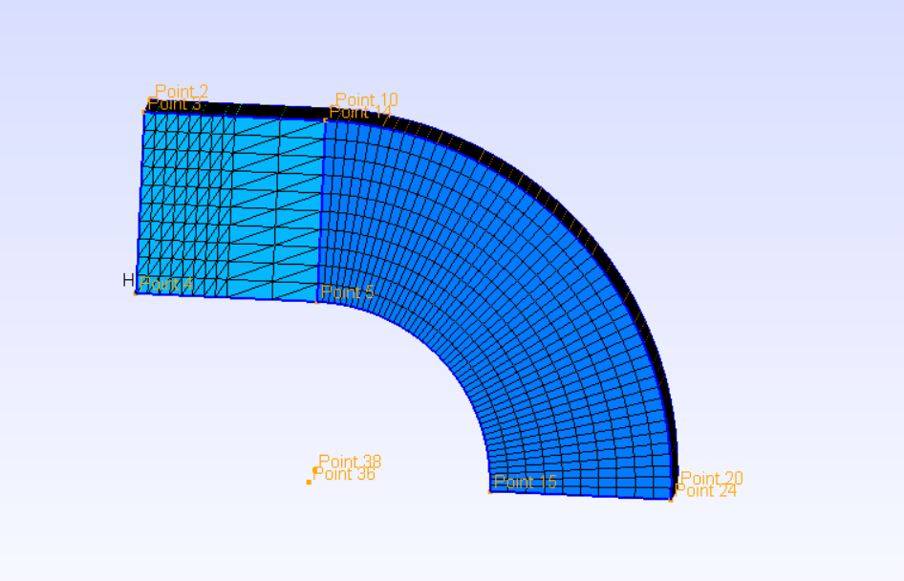
Extrusion
Converts lower-dimensional entities into higher-dimensional ones (curve→surface, surface→volume).
Supports adding structured layers during extrusion.
Can recombine elements to produce structured quads/hex meshes.

Slide 5
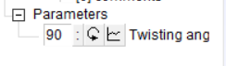
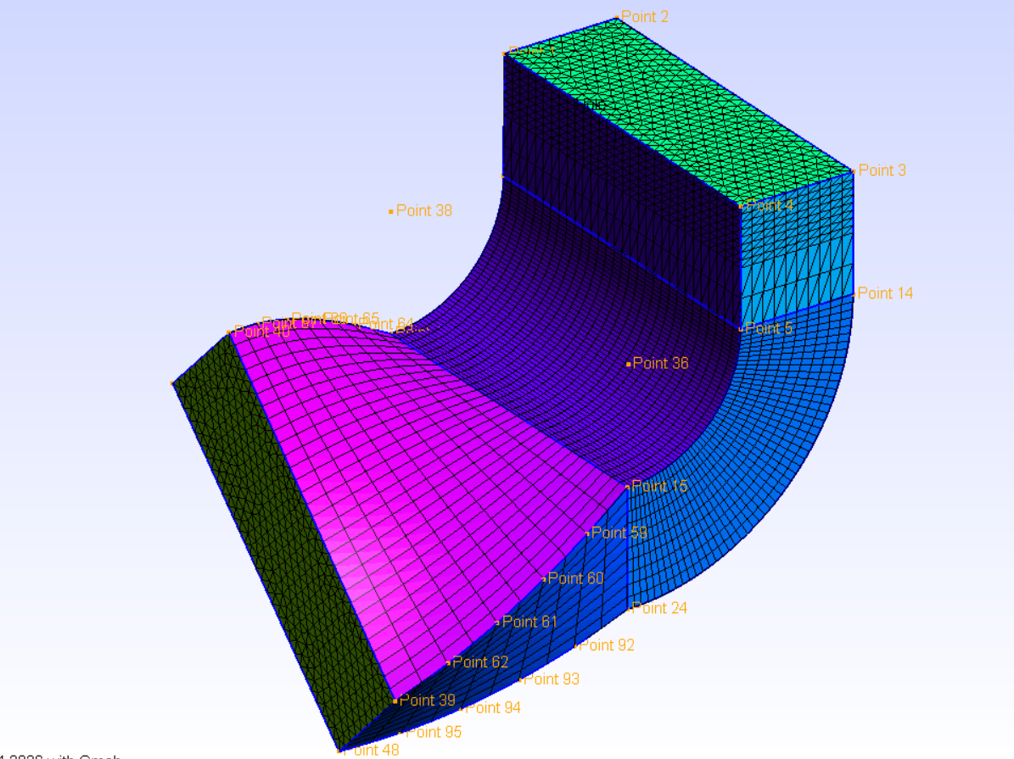
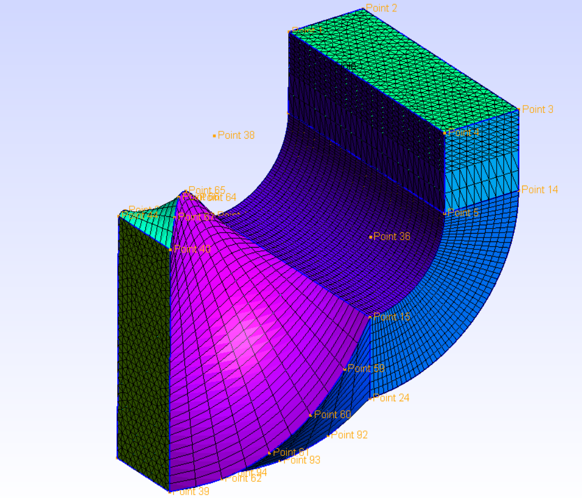
Defining parameters

Slide 6
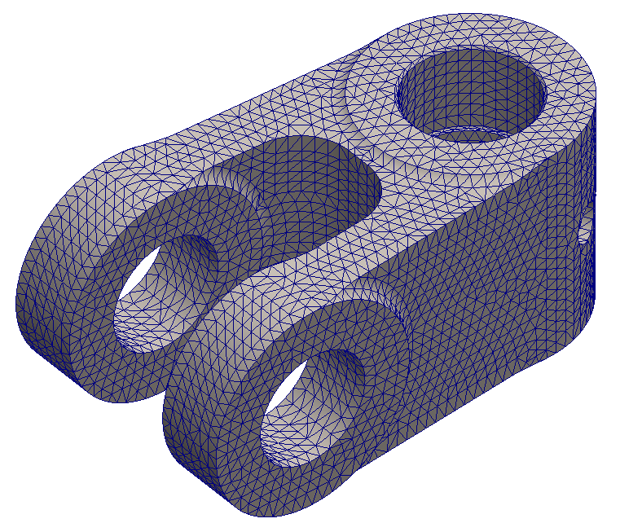
What is Meshing & How It Works
Meshing breaks a geometry into small finite elements (lines, triangles, quads, tets, hexes).
These elements allow solvers to approximate physics by solving equations on each element.
The process starts from points → curves → surfaces → volumes, ensuring topology consistency.
Mesh density controls accuracy: finer mesh captures gradients better; coarse mesh runs faster.
Meshing algorithms fill the geometry while keeping element quality, conformity, and connectivity.

Slide 7
Mesh Controlling
Controls element size, growth, and refinement
Enables local mesh refinement without global changes
Reduces computational cost while preserving accuracy
Achieved using transfinite rules or mesh fields
Essential for complex geometries

Slide 8
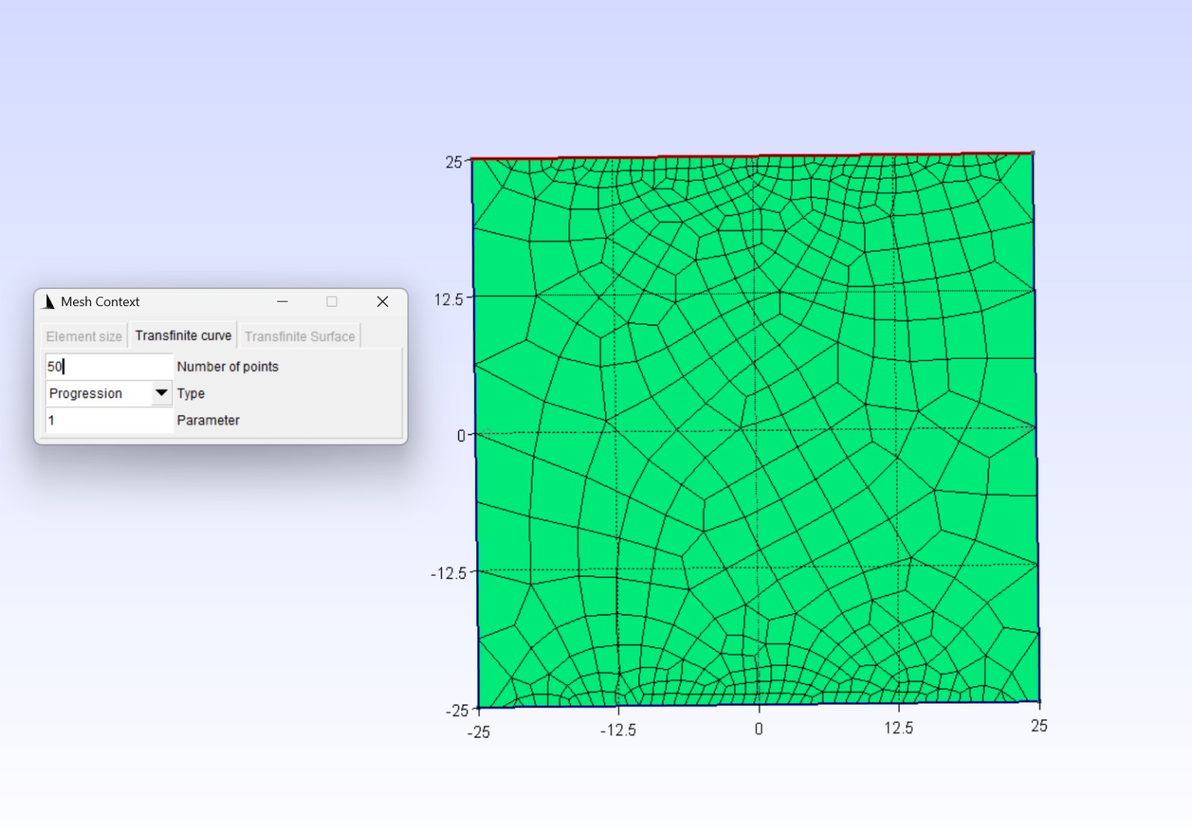
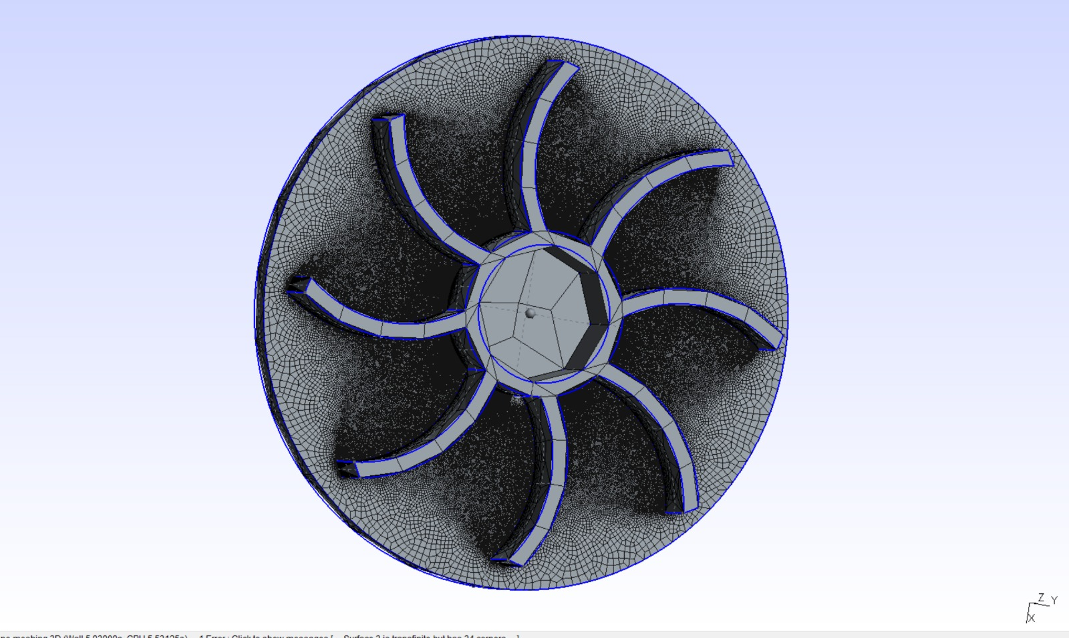
Transfinite Mesh
Structured meshing method with user-defined
node distribution
Improves mesh regularity and solver accuracy
Useful for boundary-layer and aligned flow problems
Applied to curves, surfaces, and volumes

Slide 9
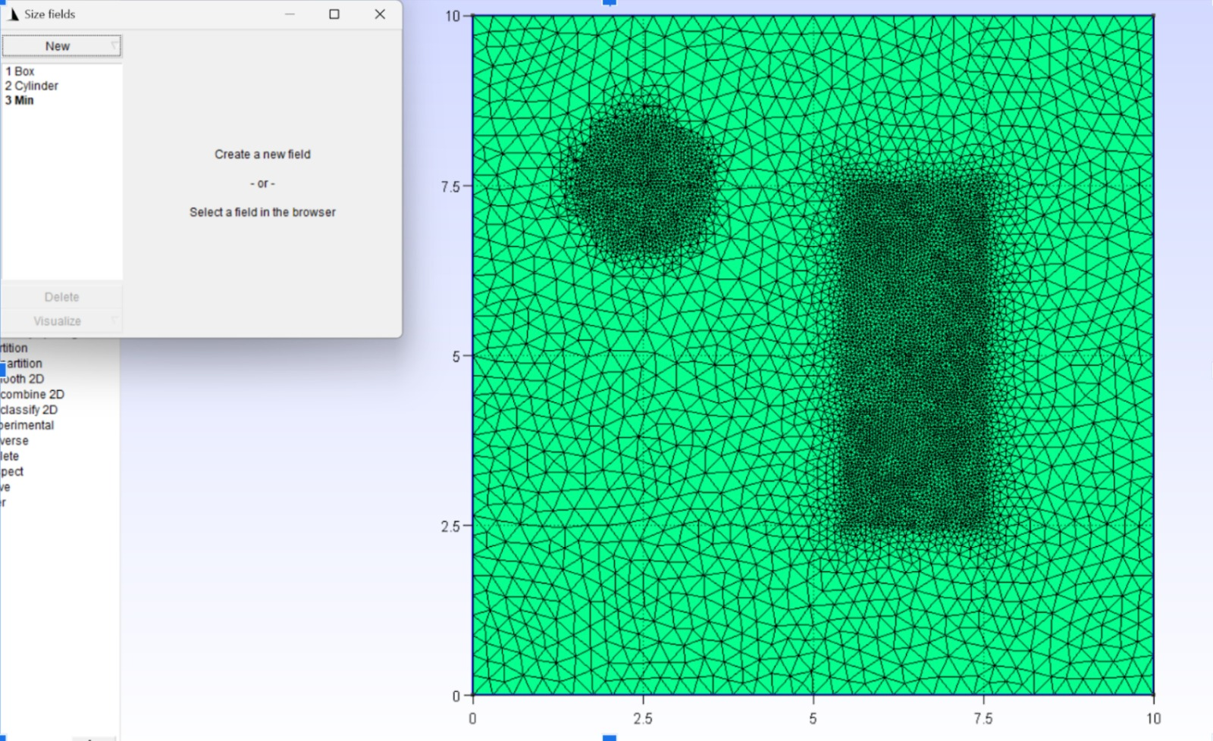
Mesh Fields (Box & Cylinder)
Box field: Refines mesh inside a rectangular region
Cylinder field: Refines mesh around cylindrical features
Used near stress concentration or flow regions
Allows spatially varying mesh size
Easily combined with other mesh controls

Slide 10
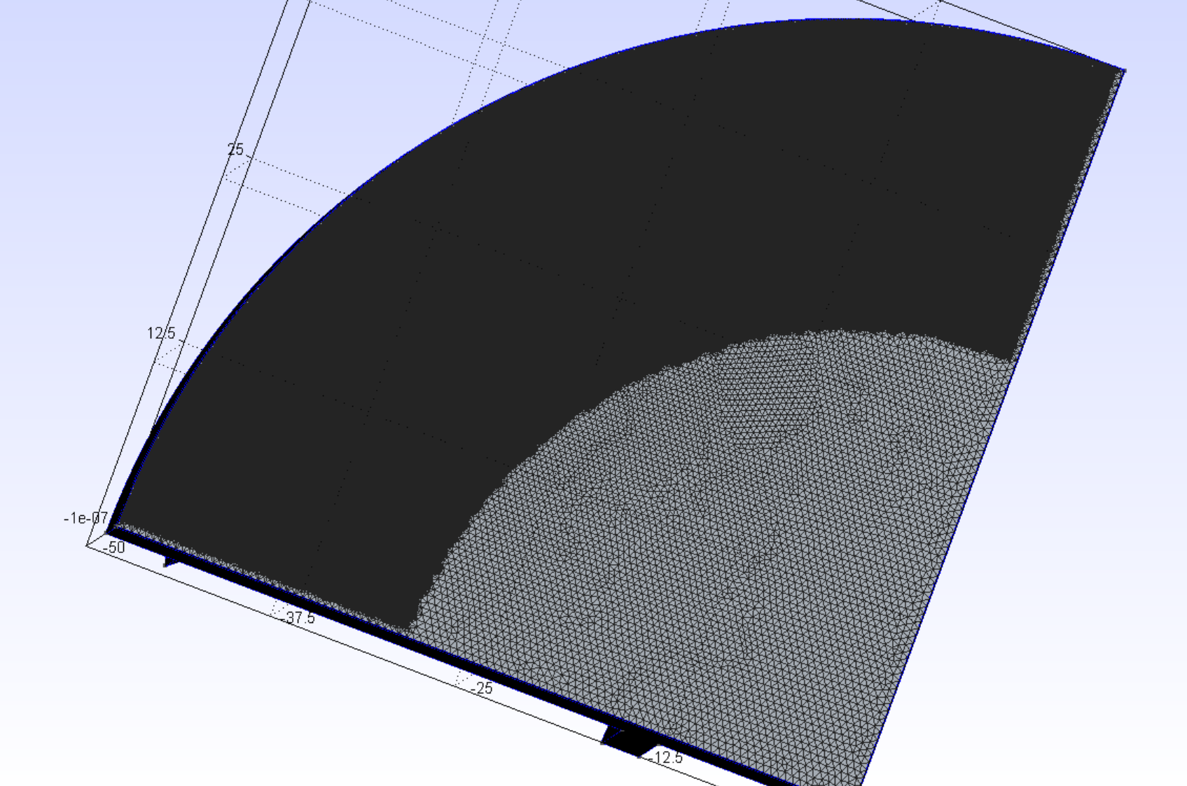
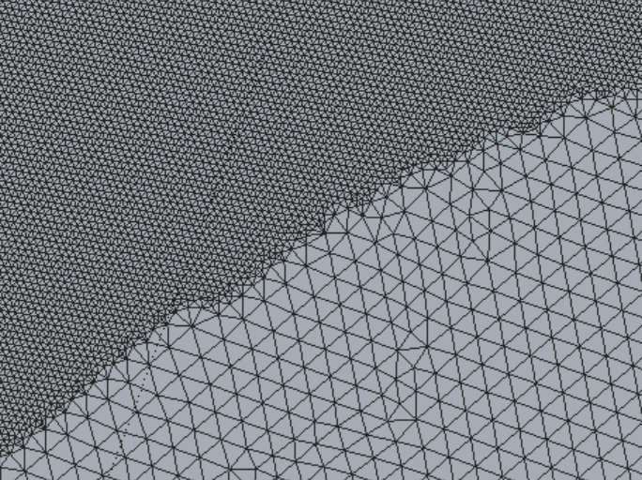
Combining Transfinite + Mesh field

Slide 11
Shell Elements
Creating 2D Surface Mesh for thin structured elements (Plates, Sheets, Shells, etc.)
GMSH does not have special feature for shell mesh, it just forms surface mesh, the thickness is provided to surface mesh in Solver (Elmer, Calculix, Ansys)
In Elmer the thickness is given as per the material Properties
Use Quadratic mesh for shell elements to get accurate results of bending, Shear, and parallel load stress.

Slide 12
Mesh Statistics
SCIN (Signed Condition Number)
How Distorted or inverted the mesh is.
Related to Jacobian
SIG (Shape Index/ Inverse Condition)
How Close is the element shape to its original shape.
1 - Perfect
GAMMA
(Size/Radius Quality Mesh)
How Stretched the element is from ideal shape.
1 - Ideal Shape
+1 - perfect 0.3 - 1 - Good
<0.3 - Acceptable
0.3-1 - OK
<0.2 - Very Stretched

